Slide 1
Scalable Systems: Overview of Design, Implementation and Use of Large Scale Clusters

Slide 2
Content
The fun stuff from
  Programming Languages
  Architecture
  Operating Systems
  Networking
  Databases
  Parallel Programming

Slide 3
What’s a large-scale cluster?
In September 2007, Google used 11,081 “machine-years” (roughly, CPU-years) on MapReduce jobs alone
  If the machines were busy 100% of the time (they’re not), and if Google did nothing but run MapReduce jobs (this is in fact a modest proportion of Google’s workload – MapReduce is used to build the index, but not to process the searches), that would be 132,972 machines!
  It’s hard to believe they don’t have 1,000,000 machines
  A rack holds 176 CPUs (88 1U dual-processor boards), so that’s about 6,000 racks
  A rack requires about 50 square feet (given datacenter cooling capabilities), so that’s about 300,000 square feet of machine room space (more than 6 football fields of real estate – although of course Google divides its machines among dozens of datacenters all over the world)

Slide 4
  A rack requires about 10kw to power, and about the same to cool, so that’s about 120,000 kw of power, or nearly 100,000,000 kwh per month ($10 million at $0.10/kwh)
    For comparison, annual power consumption – around 600M kwh – is equivalent to about 20% of Seattle City Light’s generating capacity
Microsoft and Yahoo! are in the same business
Amazon.com is in a similar business
Google is a hot star.

Slide 5
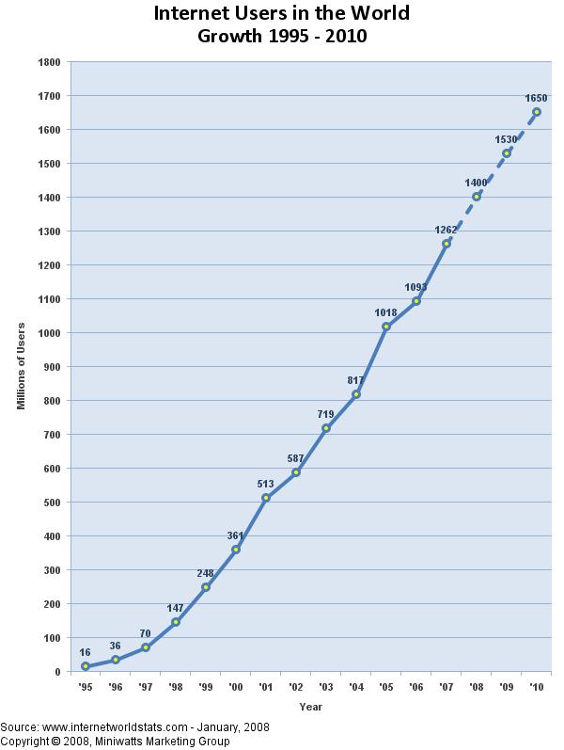
We’re drowning in users

Slide 6
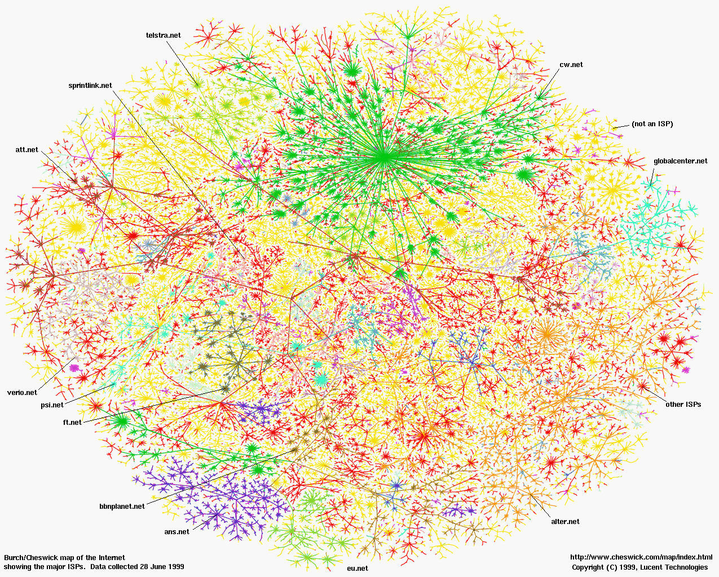
We’re drowning in data
The web
  20+ billion web pages x 20KB = 400+ terabytes
    400,000,000,000,000 (that’s a lot of zeroes!)
    One computer can read 30-35 MB/sec from disk
    ~four months to read the web
    ~1,000 hard drives to store the web

Slide 7
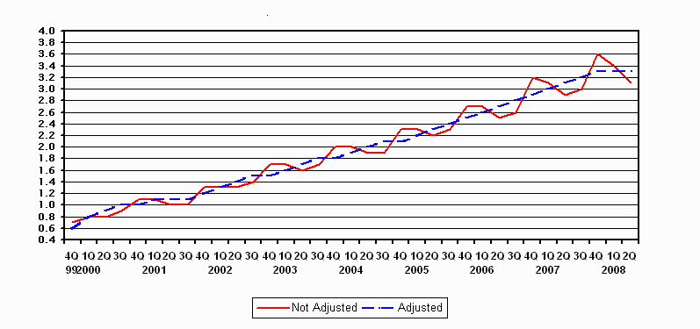
E-Commerce
  ~$35B / quarter in the US
% of total retail sales

Slide 8
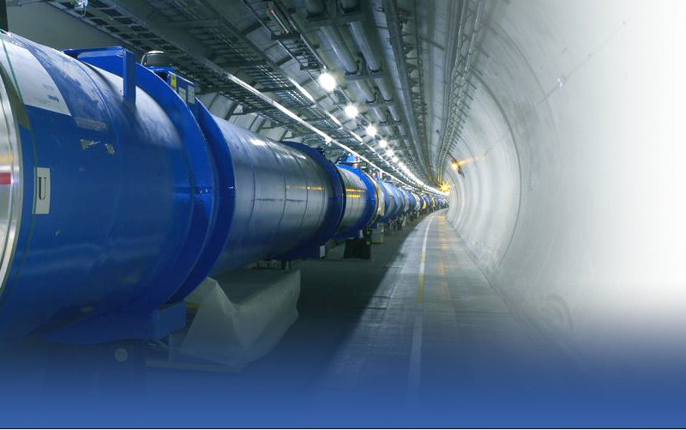
Sensors
  Point-of-sale terminals
  Gene sequencing machines
  Modern telescopes
  Large Hadron Collider

Slide 9
We need to service those users and analyze that data
Google not only stores (multiple copies of) the web, it handles an average of 3000 searches per second (7 billion searches per month)!
The LHC will produce 700 MB of data per second – 60 terabytes per day – 20 petabytes per year
  Hopefully they’re going to analyze this data, because it cost $6 billion to build the sucker
The only hope: concurrent processing / parallel computing / distributed computing, at enormous scale

Slide 10
Traditional parallel computing
Consider a really stupid example: multiplying two NxN matrices for huge N
  C[i,j] = sum k=1..N A[i,k]*B[k,j]
=
X

Slide 11
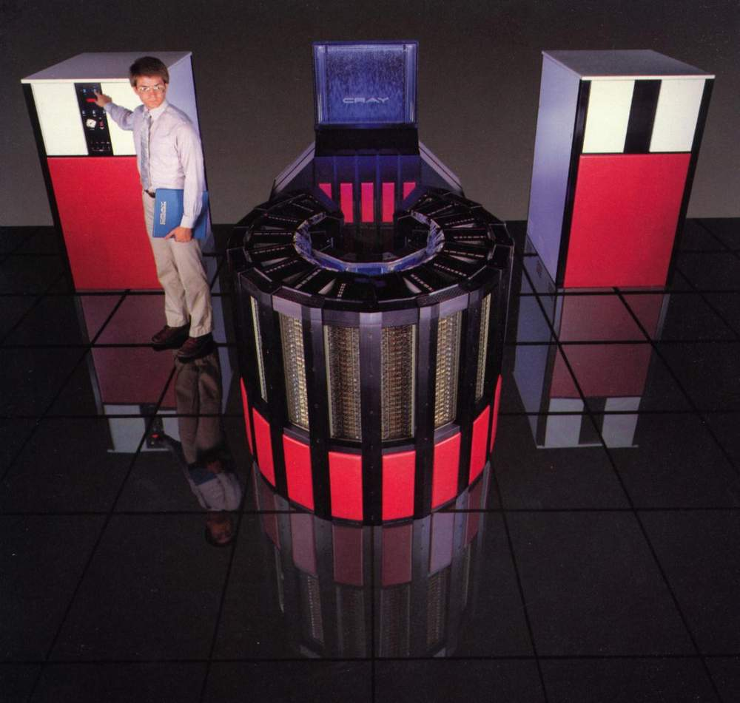
SIMD (Single instruction, multiple data) / vector processors
  Vector programming model
  Performance and reliability through hugely expensive components
  Example: https://www.youtube.com/watch?v=o_n4AKwdfiA

Slide 12
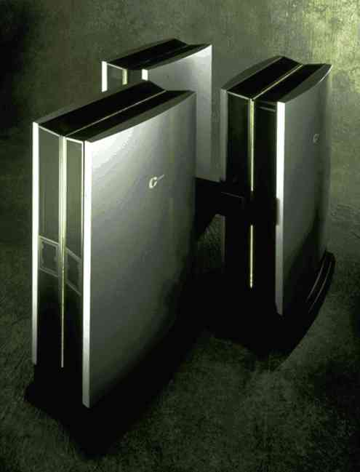
MIMD (Multiple instruction, multiple data) / shared-memory multiprocessors
  Shared memory programming model
  High-performance interconnect providing cache coherence
  Single copy of the OS
  All CPUs are equally “close” to all memory and disks

Slide 13
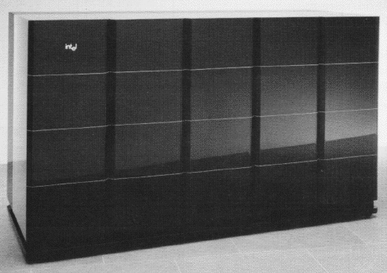
MIMD / message-passing multiprocessors
  Message-passing programming model
  Multiple copies of the OS
  High-performance interconnect
  Typically, processors
  do not have local disk
  storage
Example: https://www.youtube.com/watch?v=KVOc6369-Lo

Slide 14
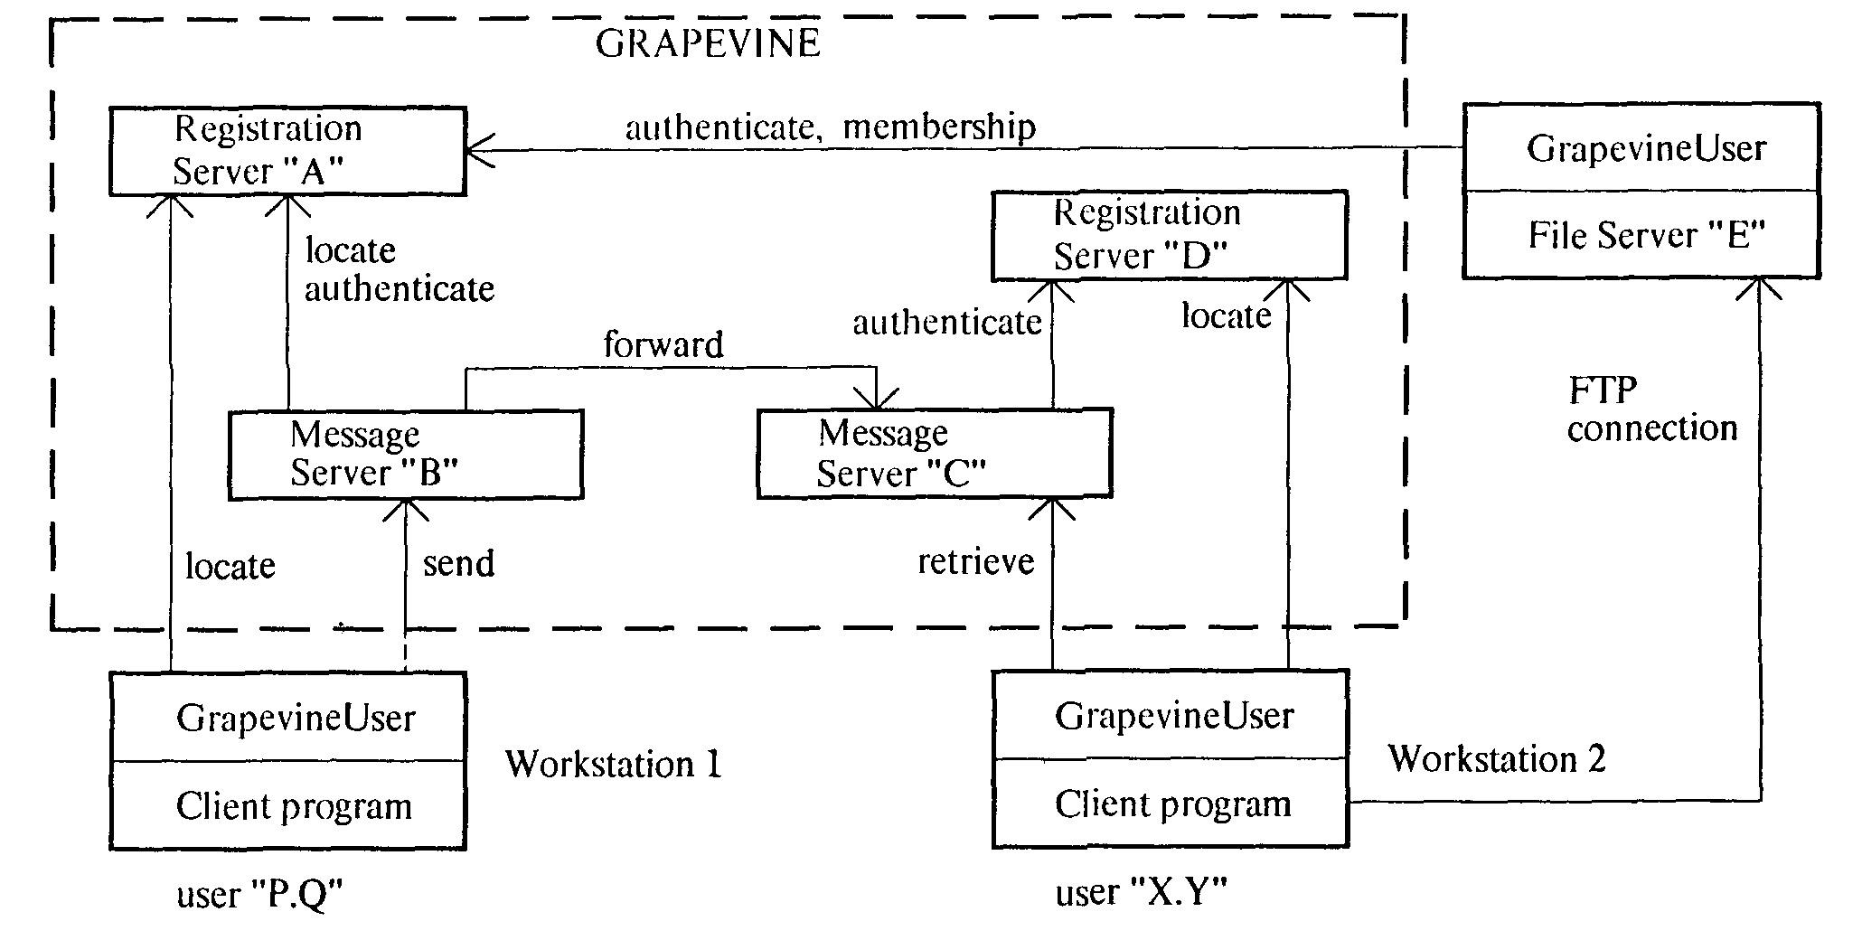
Traditional distributed computing
Client/server
  Lots of concurrency, but no attempt to speed up a single app
  Cheap hardware; modest inter-machine bandwidth
  Reliability via software
  Highly scalable

Slide 15
Let’s talk about reliability

Slide 16
Is there a middle ground – best of both worlds?
Speeds up the solution of extremely large problems/applications
Uses a distributed system structure
  Highly scalable
  Cheap components
  Reliability achieved via software
  Modest interconnect bandwidth
Simple programming model

Slide 17
We need problems that are “embarrassingly parallel”
We’re dealing with thousands of independent computers with local memory and local disk (cheesy disks – not even SCSI)
Interconnection bandwidth is significant, but not monstrous – commodity fast Ethernet switches
Thus, communication is relatively expensive – the problem must be decomposable into pieces that are pretty much independent of one another
Can you think of some problems that are like this?

Slide 18
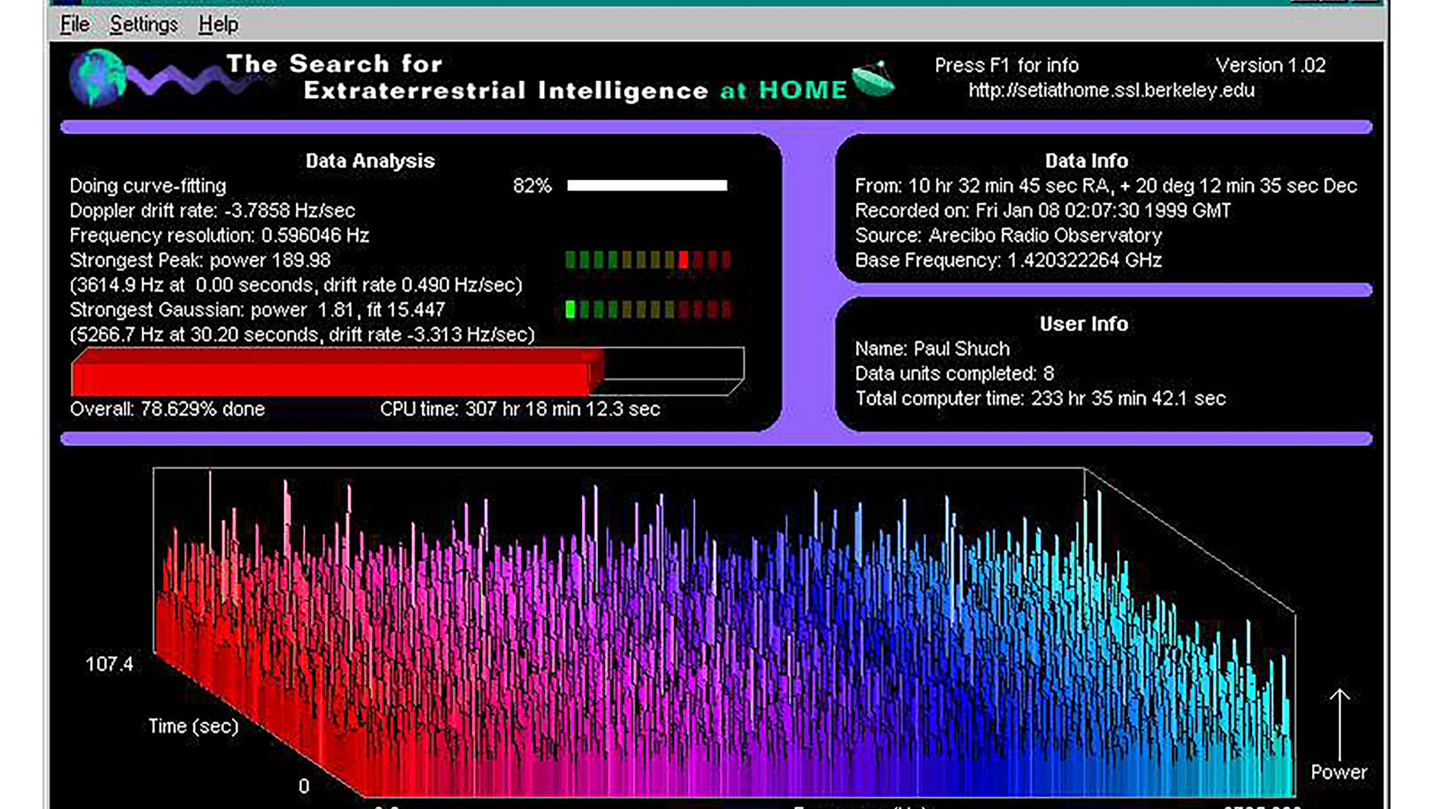
https://www.youtube.com/watch?v=_aIJV5aQR68

Slide 19
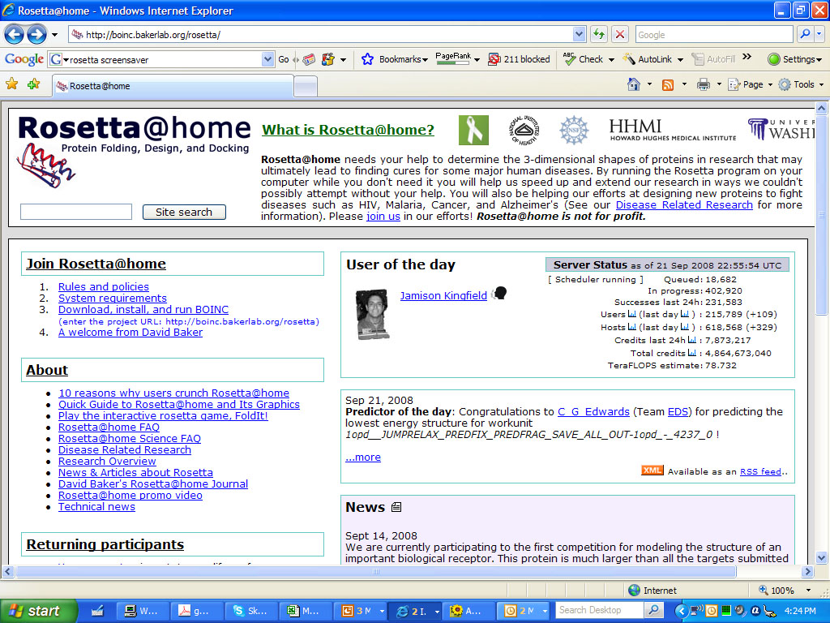

Slide 20
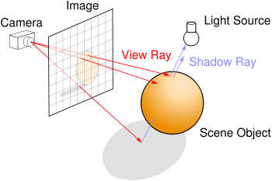
Ray tracing in computer graphics
  Render a scene by tracing rays from the eye to objects in the scene
    Each ray is independent
Compute a web index
  For each of 20+ billion web pages, make a list of the words it contains
  Invert this index – for each of however many words there are, make a list of the web pages on which it appears

Slide 21
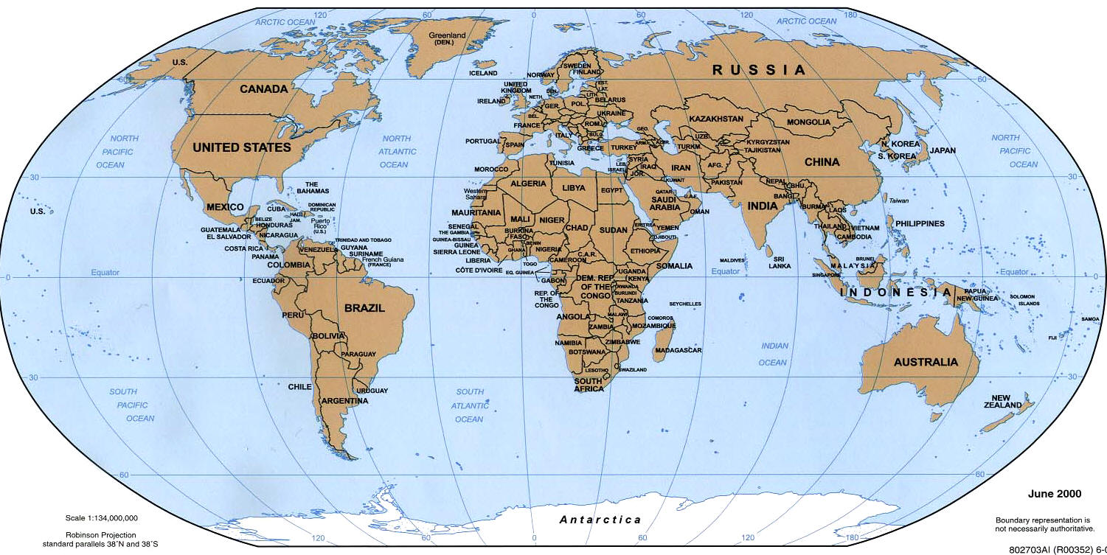
Answering a Google search request – a single search request
  There are multiple clusters (of thousands of computers each) all over the world
  DNS routes your search to a nearby cluster

Slide 22
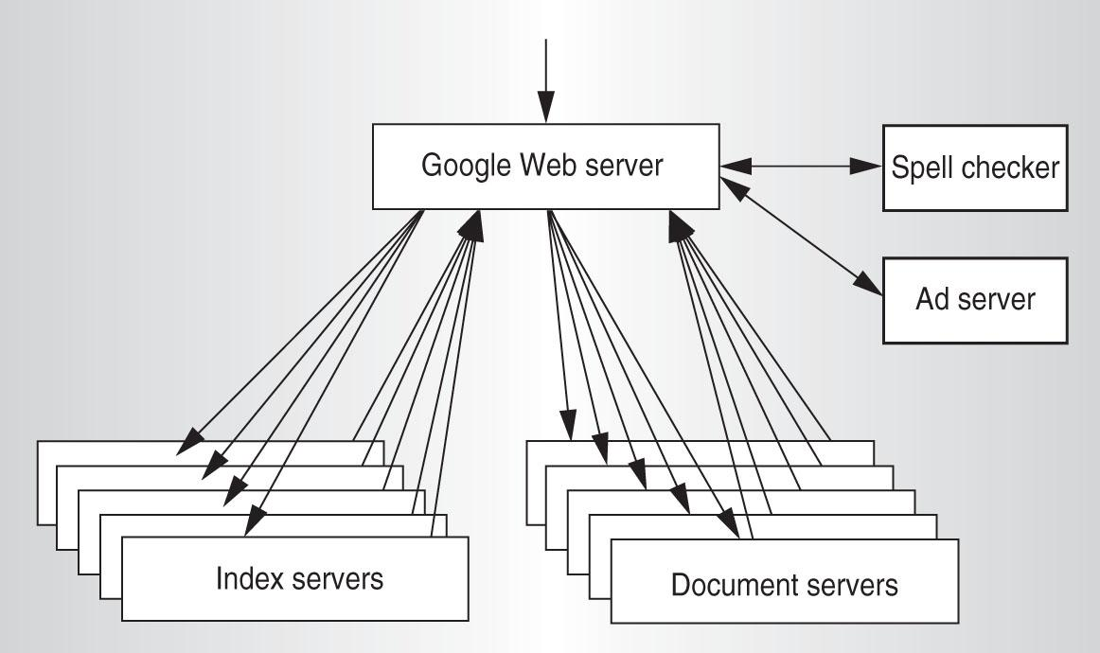
  A cluster consists of Google Web Servers, Index Servers, Doc Servers, and various other servers (ads, spell checking, etc.)
  These are cheap standalone computers, rack-mounted, connected by commodity networking gear

Slide 23
  Within the cluster, load-balancing routes your search to a lightly-loaded Google Web Server (GWS), which will coordinate the search and response
  The index is partitioned into “shards.” Each shard indexes a subset of the docs (web pages). Each shard can be searched by multiple computers – “index servers”
  The GWS routes your search to one index server associated with each shard, through another load-balancer
  When the dust has settled, the result is an ID for every doc satisfying your search, rank-ordered by relevance

Slide 24
  The docs, too, are partitioned into “shards” – the partitioning is a hash on the doc ID. Each shard contains the full text of a subset of the docs. Each shard can be searched by multiple computers – “doc servers”
  The GWS sends appropriate doc IDs to one doc server associated with each relevant shard
  When the dust has settled, the result is a URL, a title, and a summary for every relevant doc

Slide 25
  Meanwhile, the ad server has done its thing, the spell checker has done its thing, etc.
  The GWS builds an HTTP response to your search and ships it off

Slide 26
Many hundreds of computers are involved in responding to a single search request
The system must have the following characteristics:
  Fault-Tolerant
    It can recover from component failures without performing incorrect actions
  Highly Available
    It can restore operations, permitting it to resume providing services even when some components have failed
  Recoverable
    Failed components can restart themselves and rejoin the system, after the cause of failure has been repaired
  Consistent
    The system can coordinate actions by multiple components, often in the presence of concurrency and failure

Slide 27
  Scalable
    It can operate correctly even as some aspect of the system is scaled to a larger size
  Predictable Performance
    The ability to provide desired responsiveness in a timely manner
  Secure
    The system authenticates access to data and services

Slide 28
The system also must support a straightforward programming model
  Mere mortals must be able to write apps
And it must be cheap
  A Google rack (176 2-GHz Xeon CPUs, 176 Gbytes of RAM, 7 Tbytes of disk) costs about $300K; 6,000 racks ~ $2B
  You could easily pay 2x this or more for “more robust” hardware (e.g., high-quality SCSI disks, bleeding-edge CPUs)
  And if you wanted a “traditional” multiprocessor with very high bisection bandwidth, the cost would be astronomical (and you couldn’t achieve anything like this scale)

Slide 29
You cannot make any of the following assumptions
  Hardware
    Components are reliable
    Components are homogeneous
  Software
    It’s correct
  Network
    Latency is zero
    Bandwidth is infinite
    It’s secure
  Overall system
    Configuration is stable
    There is one administrator

Slide 30
But you tell me …
How does the Google search application achieve those characteristics (fault-tolerant, highly-available, recoverable, scalable, etc.)?

Slide 31
Where does the Google search application use replication? Where does it use partitioning?

Slide 32
How on earth would you enable mere mortals write hairy applications such as this?
Recognize that many Google applications have the same structure
  Apply a “map” operation to each logical record in order to compute a set of intermediate key/value pairs
  Apply a “reduce” operation to all the values that share the same key in order to combine the derived data appropriately
Example: Count the number of occurrences of each word in a large collection of documents
  Map: Emit <word, 1> each time you encounter a word
  Reduce: Sum the values for each word

Slide 33
Build a runtime library that handles all the details, accepting a couple of customization functions from the user – a Map function and a Reduce function
That’s what MapReduce is
  Supported by the Google File System and the Chubby lock manager
  Augmented by the BigTable not-quite-a-database system

Slide 34
Some terminology
MapReduce
  The LISP functional programming “Map / Reduce” way of thinking about problem solving
  Also, the name of Google’s runtime library supporting this programming paradigm at enormous scale
Hadoop
  An open source implementation of the MapReduce functionality
Dryad
  Microsoft’s version

Slide 35
Cloud computing
  Computing “out there somewhere” rather than on your desktop or in your datacenter
  Gmail, Google Docs, Salesforce.com, etc.
  Because cloud computing takes place at enormous scale, it requires many of the techniques we’ll discuss in this class
Amazon Web Services
  A commercial service that lets you deploy your own cloud computing applications
  Offers computing, storage, database services, etc.

Slide 36
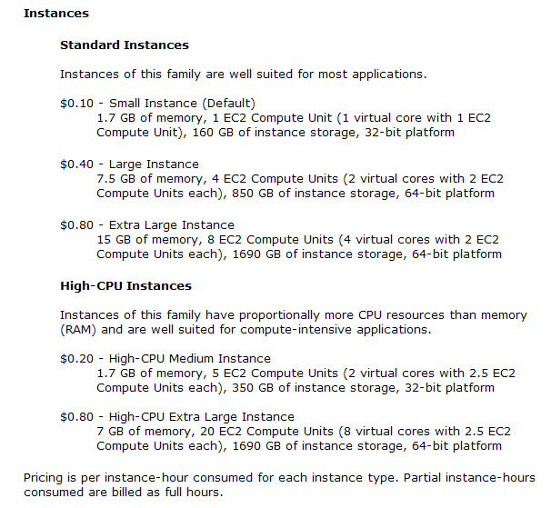

Notes:
‹#›

Slide 37
  This includes
    Purchase + replacement
    Housing
    Power
    Operation
    Instantaneous expansion and contraction
  Enables VC-less (or VC-lite) web service companies
  Enables focus on your core business, not generic infrastructure
  1000 processors for 1 hour costs the same as 1 processor for 1000 hours
    Revolutionary!
  Your application doesn’t run decently on this environment?
    Start figuring out how to change that!

